Slide 1

MLE Capstone Project - Fraud Detection Team R-A-A-M

Slide 2

A Tiny History

Slide 3





Business Problem
Build an intelligent and automated mechanism to detect fraudulent banking transactions and don’t process further!!!

Slide 4



From a real world problem to our machine learning problem
Binary classification
OR

Slide 5
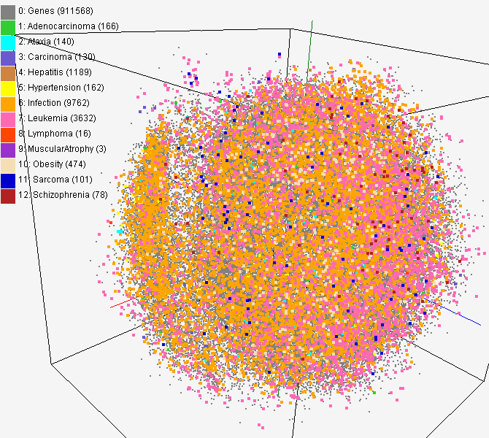
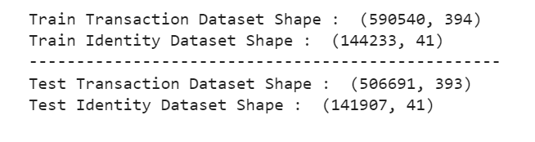
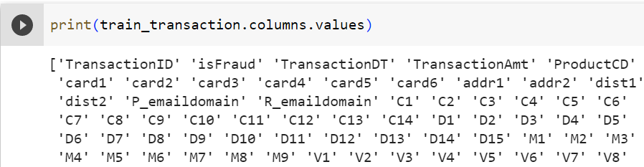
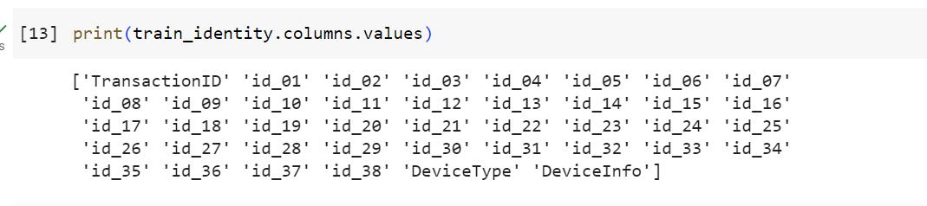
Let’s begin the journey
Transaction Data, Identity Data
Large scale data with high dimensionality
Obscured column names

Slide 6
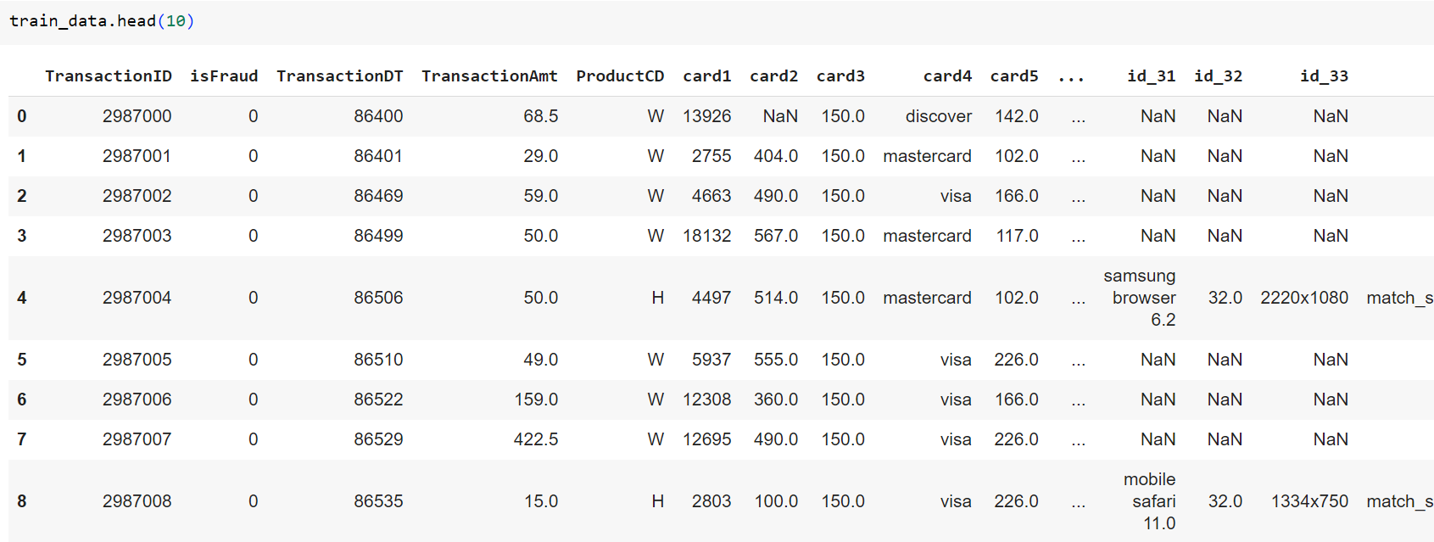
Glimpse of the data

Slide 7
High level steps to follow
Model
Evaluation
ML Problem
Analyze Data
3
Prediction
Data Cleanup and Feature Engineering
Model Training
With Proper Hyper Params
Choose Model Algorithms

Slide 8


Data Analysis
3

Slide 9
Analyzing entire dataset. Some observations are below.
No duplicate rows/columns
Large number of missing values - this pattern helps us eventually
Not much outlier features as well
Single feature analysis - to understand how data is distributed
Multi feature analysis - to understand how correlation is established
3

Slide 10
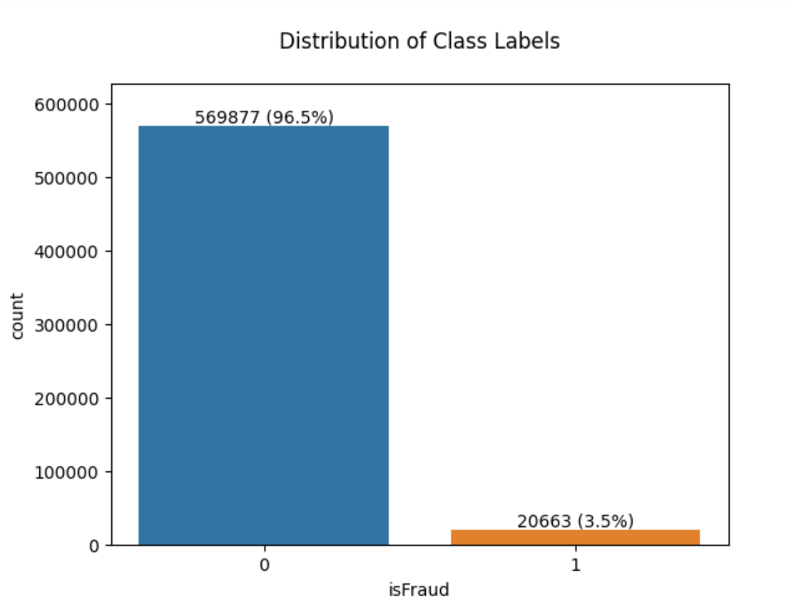
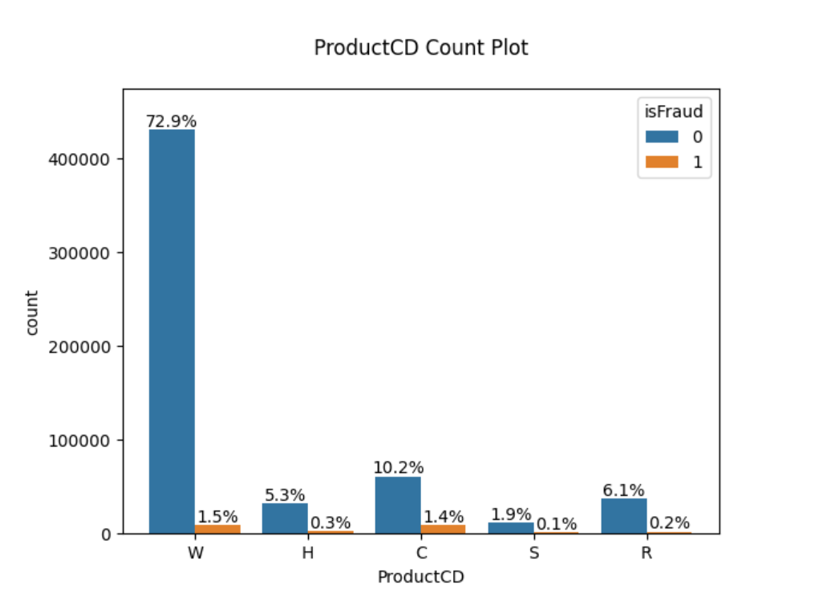
Single feature analysis
3

Slide 11
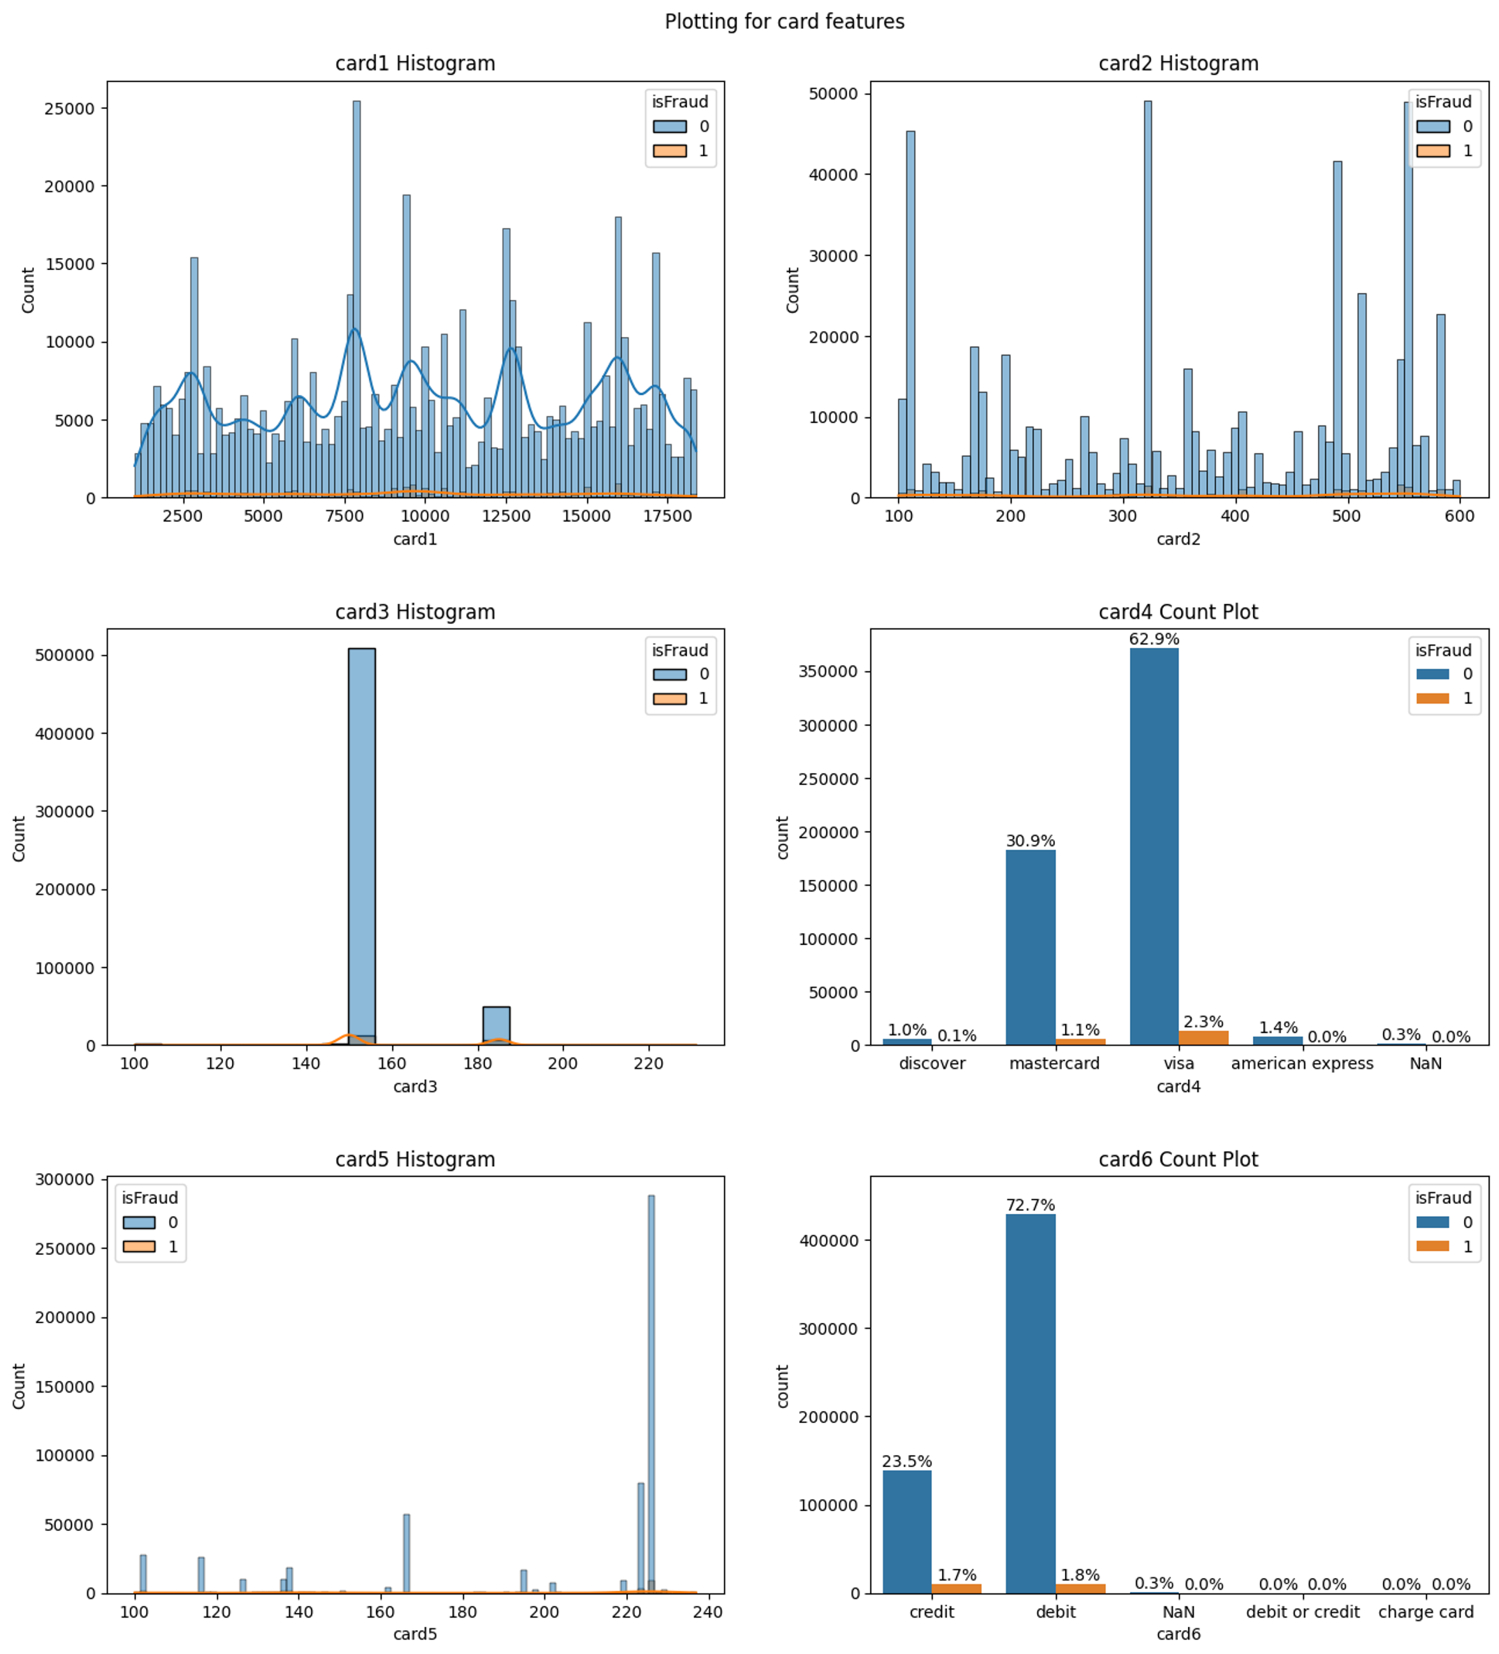
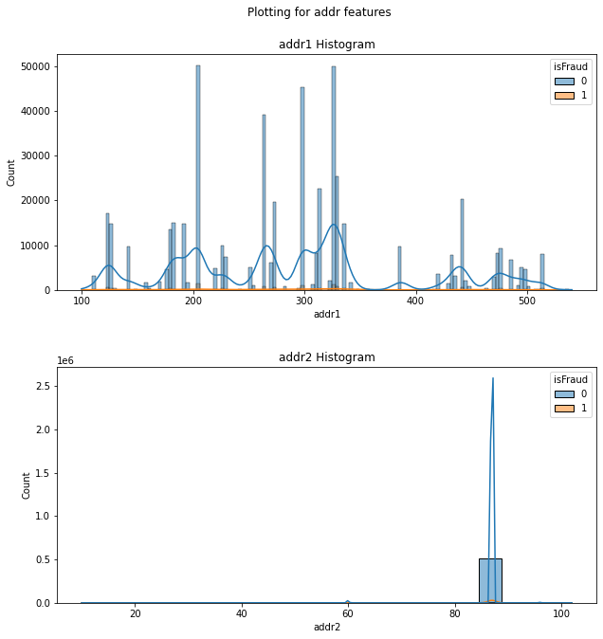
Single feature analysis
3

Slide 12
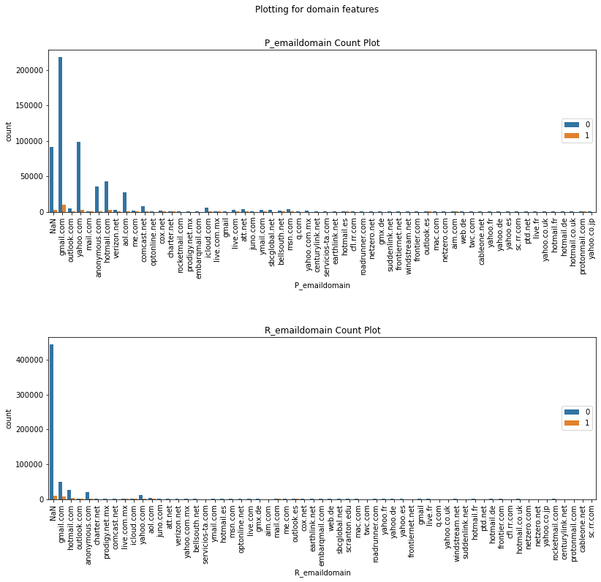
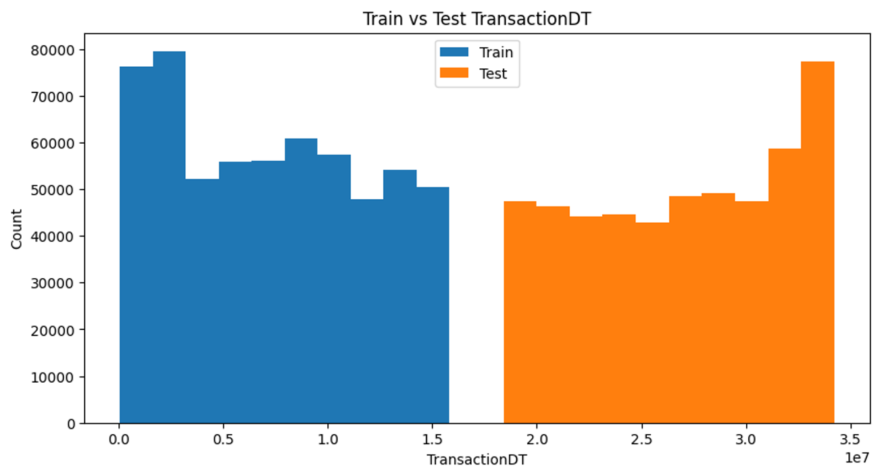
Single feature analysis
3
Device Type with Mobile has high fraud transactions relative to number of transactions

Slide 13
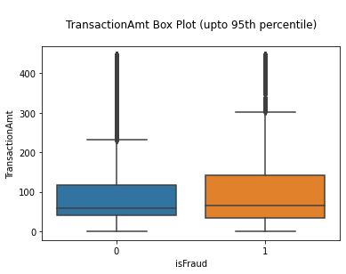
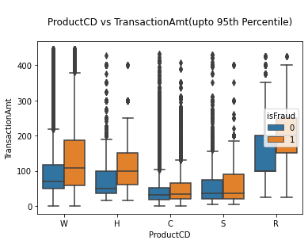
Multi feature analysis
C1-14 features are highly inter correlated
3

Slide 14
Basic modelling with initial data cleanup
Blind check whether data fits properly for linear or non-linear model
Tried with Logistic regression and Random Forest models
LR = 0.7432942730382361 RF = 0.9899745995190842
Ensemble models like Random forest gives good training score.
3

Slide 15
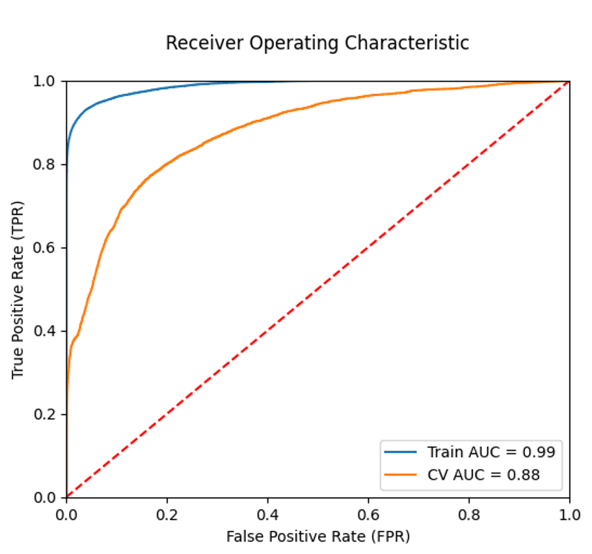
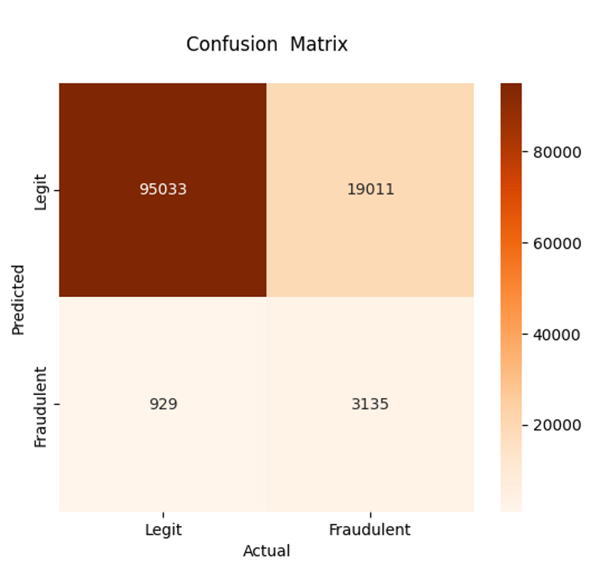
XGBoost model with hyper parameter tuning
3
Clearly overfit !!! Quite obvious.

Slide 16

Prevent overfitting
More data cleanup
Reducing features using PCA
3

Slide 17

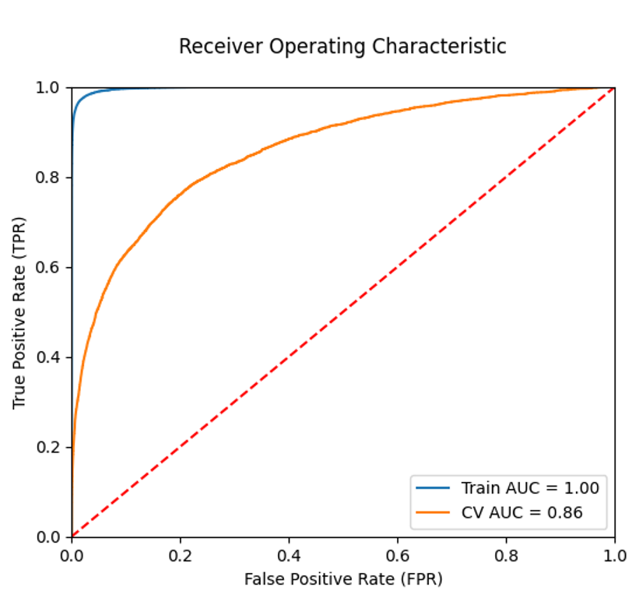
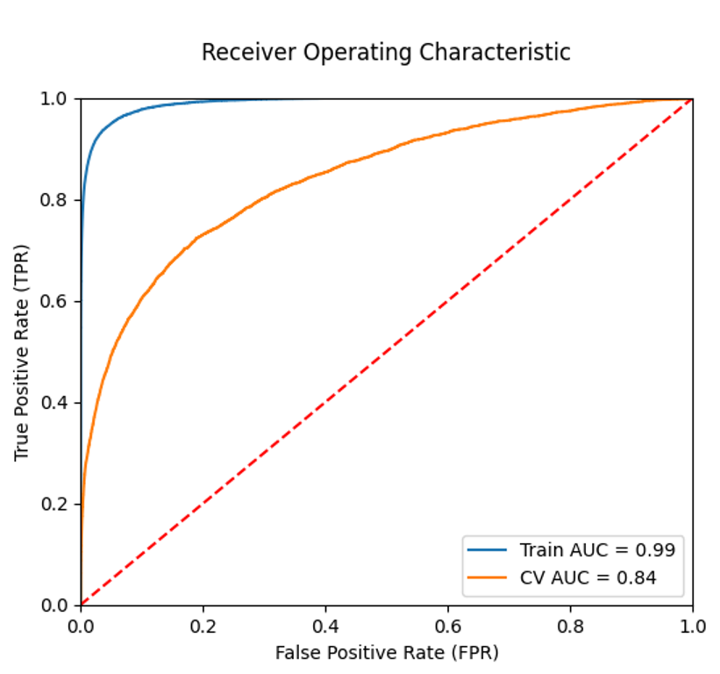
PCA
40 components
20 components
3

Slide 18
Manual Features Reduction
More Data cleanup
Reducing features with help of data patterns
Lot of correlational features are observed in initial data analysis for
C, D, ID, V series features.
Our main interest is V series as it is 340 in number.
The missing values pattern helped here.
3

Slide 19
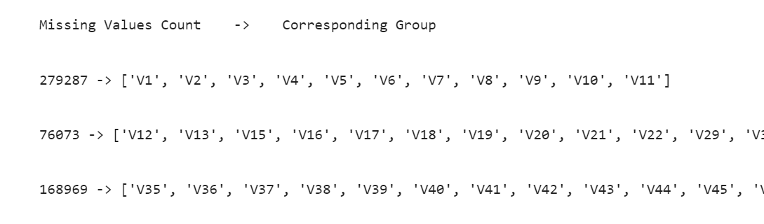
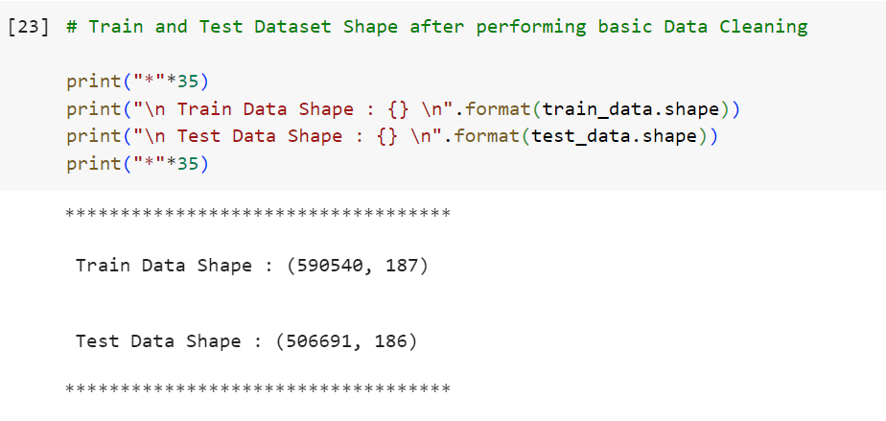
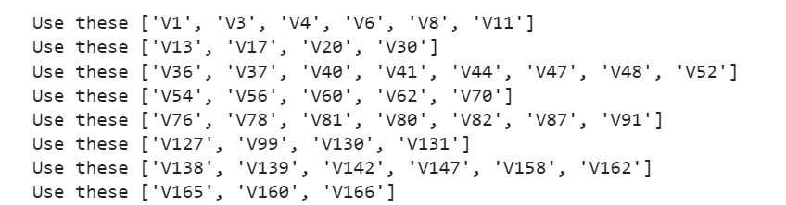
Reducing V series
Grouping based on NAN count
3
Remove redundant features based correlational score

Slide 20
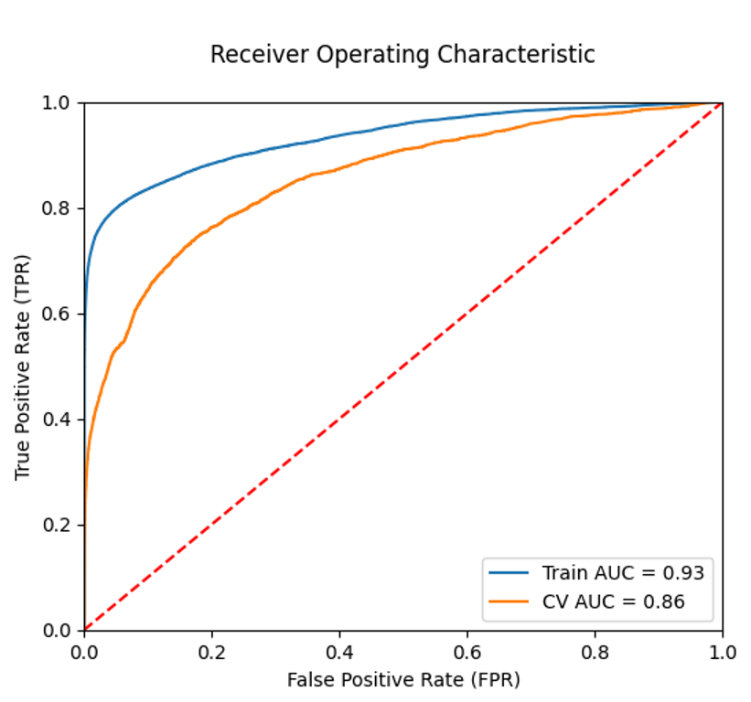

XGBoost Modelling - Intermediate
With reduced features set (~ 187 features)
3
Variance got reduced a bit !!!

Slide 21

Reducing Variance
Splitting columns
Creating interaction features from other columns (combining/transforming)
Creating Aggregated columns using unique group identifier
Frequency encoding etc..
3
Some techniques are referred from Kaggle
References which are added in last slides.

Slide 22

3

Slide 23
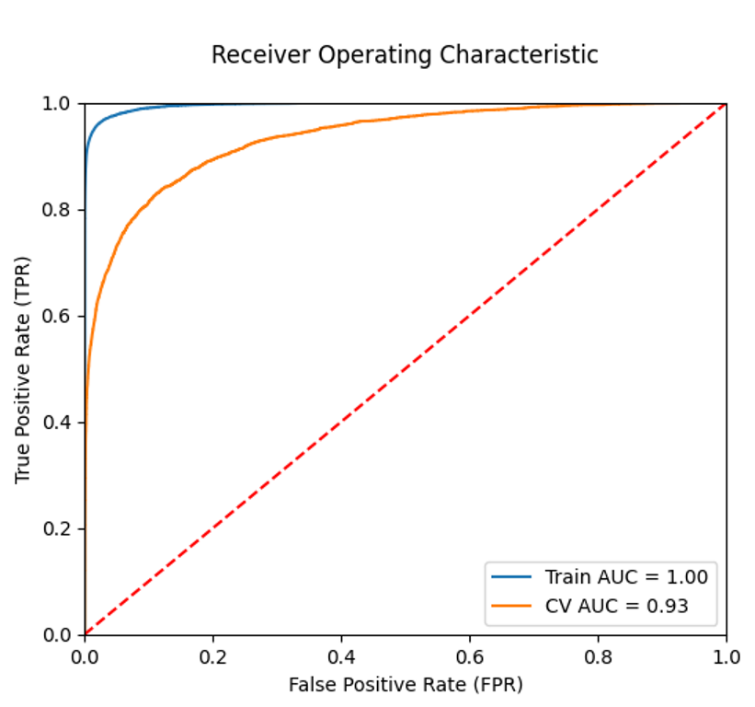
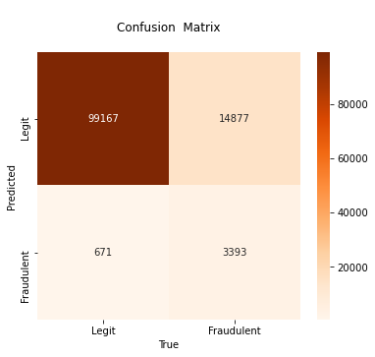
XGBoost Modelling - Final
With new features set (~ 314 features)
With a new set of hyper parameters
3

Slide 24
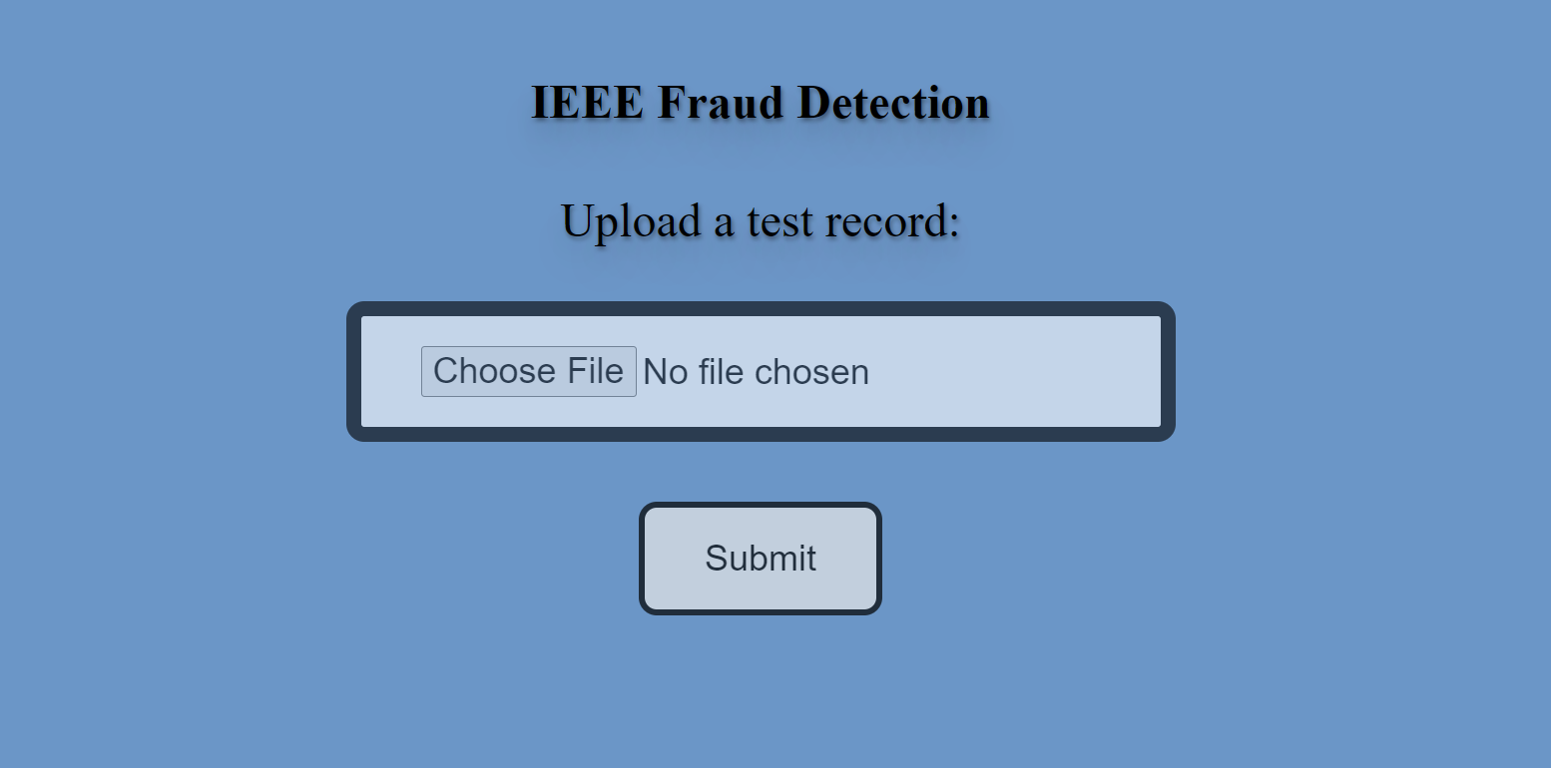
Model Deployment
3

Slide 25
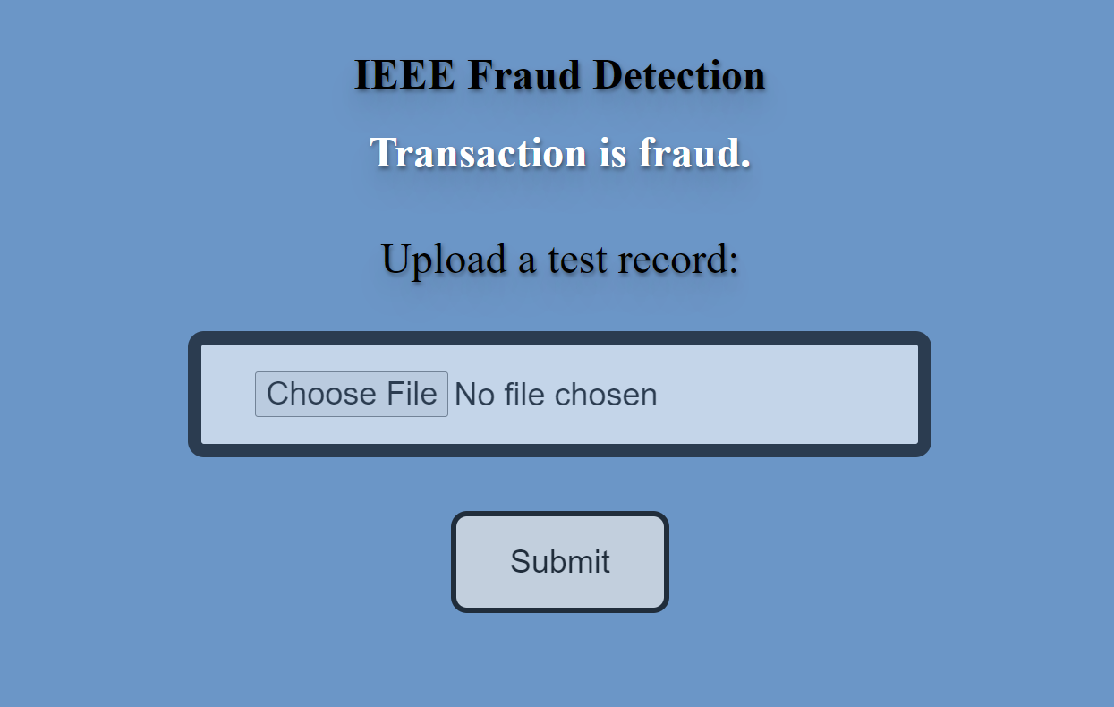
Predicting new data - Fraud
3

Slide 26
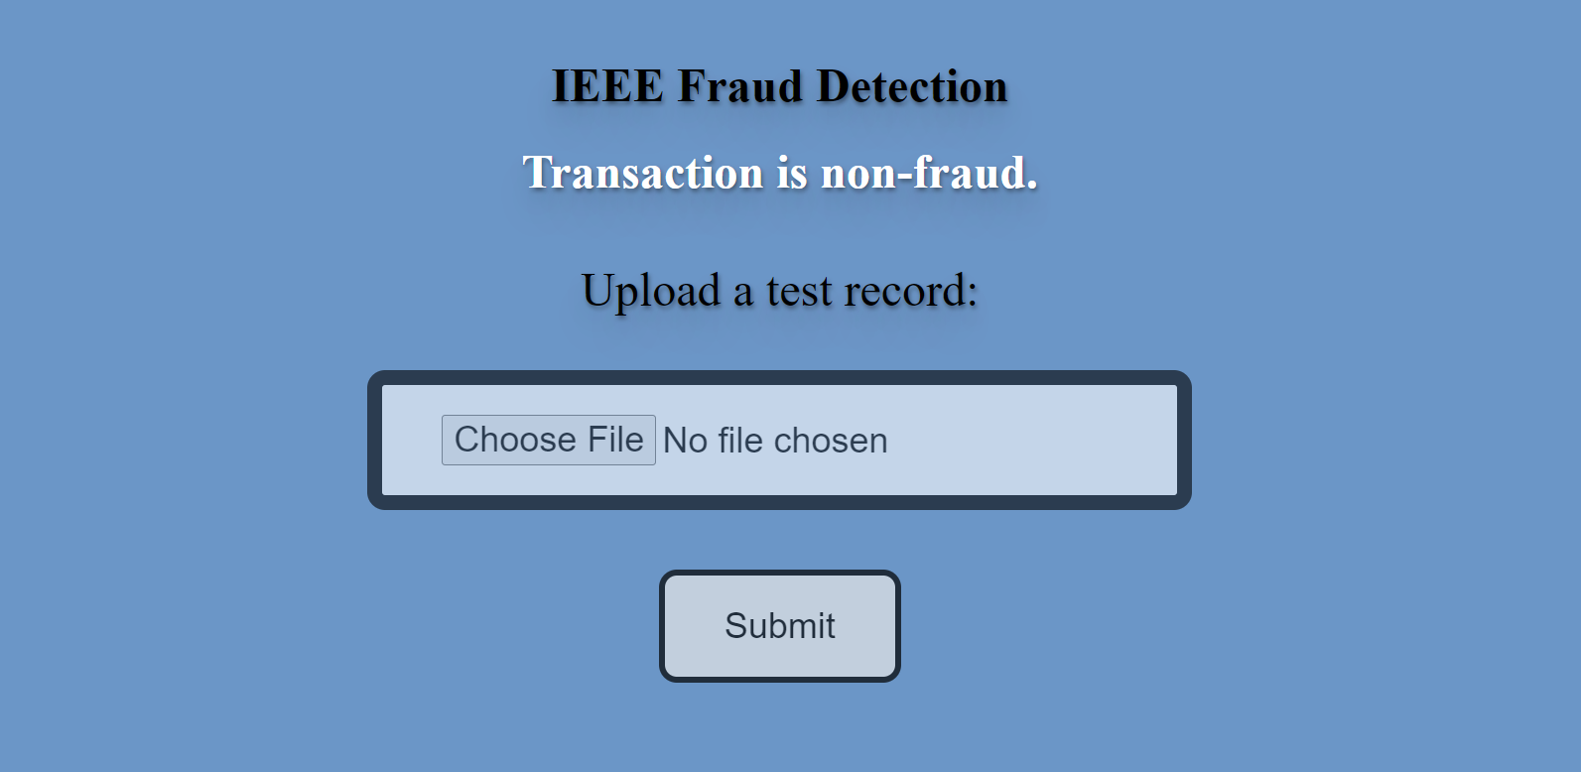
Predicting new data – Not Fraud
3

Slide 27
Observations on XGBoost
Training time is very huge on CPU runtime. Approximately 1 hour.
Relatively very less with GPU. Around 15 minutes.
For hyper parameter tuning, sometimes collab machine restarts due to out of memory.
3

Slide 28


3

Slide 29
What’s next?
Need to do apply more feature selection techniques/feature engineering
Try different cross validation techniques – Adversarial validation
Try and evaluate different tree based models like LGBM, CATBOOST
Comparison of time metrics on running with GPU/CPU at each step
Integrate Explainable AI Dashboards - Glimpse in later slides
3

Slide 30
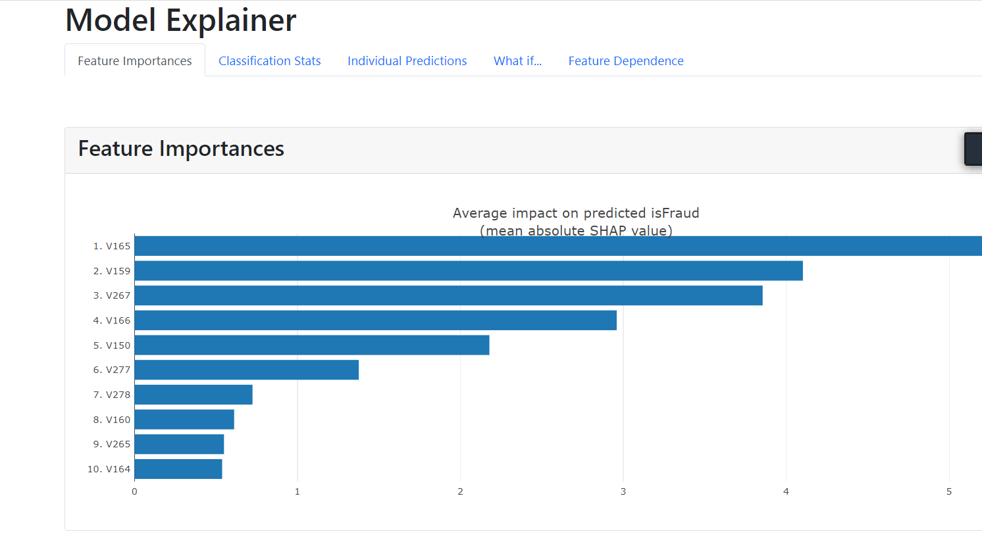
Model Explainability
3

Slide 31
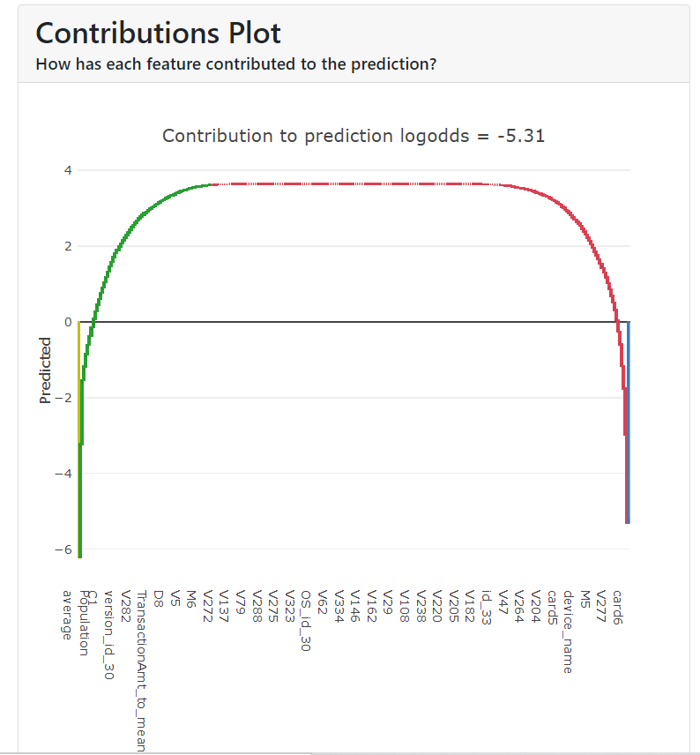
Model Explainability
3

Slide 32
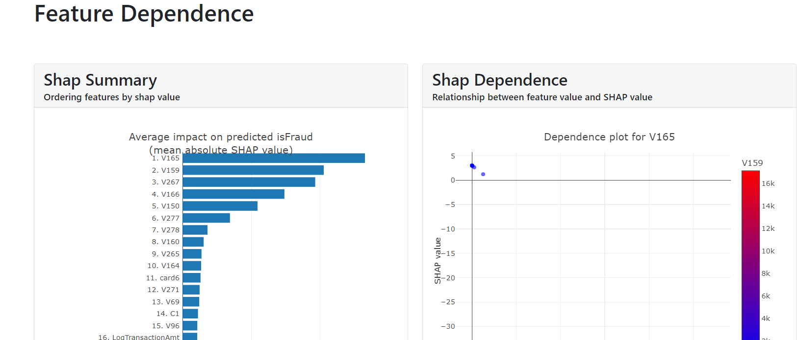
Model Explainability
3

Slide 33
References
https://www.kaggle.com/c/ieee-fraud-detection/discussion/108575#latest-641841
https://www.kaggle.com/code/kyakovlev/ieee-fe-for-local-test/notebook
3

Slide 34
Thank you
3

